Slide 1
SOLAR-POWERED PA SYSTEM
Cost Evaluation & Connection Simulation
Based on the project's multi-vendor market price survey (N-Type vs. Average Price)
Prepared by Eno | University of Lagos Engineering Society – Academic & Research Board

Slide 2
COST EVALUATION — MARKET PRICE SURVEY
Items 1–9 (power subsystem), as compiled across multiple supplier quotes. Figures in ₦ (Naira).
Item | Price | Minimal (₦) | Maximal Price (₦)
1. Solar Panel 250W, Monocrystalline (N –Type) 2. MPPT Charge Controller 20–30A, 12/24V 3. Battery 100ah, 12V LiFePO4 4. Inverter 500W, Pure Sine Wave | 1 2 3 4 | 50,000 25,000 120,000 35,000 | 110,000 50,000 200,000 50,000
5. Audio Mixer ,Multi-Channel 6. Amplifier 150 –300W 7. Wireless Microphone (Lapel/Handheld) | 5 6 7 | 45,000 70,000 30,000 | 160,000 120,000 90,000
8. Active PA Speakers Wireless, Built-in Amp ×2 9. Cables and Connectors 10. Contingency | 8 9 10 | 100,000 50,000 50,000 | 250,000 80,000 100,000
WORKSHEET TOTALS
As summed directly from all surveyed options:
Subtotal — Items 1–10
₦575,000 → ₦1,210,000
Wireless Microphone (Lapel/Handheld) :
Implied unit price: ₦ 30,000→ ₦90,000
(back-calculated from the running total below)
N-Type (budget/generic) → Average (branded/market)
2

Slide 3
FULL PROJECT BUDGET OUTLOOK
Items 1–9 use the primary surveyed option per component
# | Component | / Est. (₦) | Average / Est. (₦) | Status
1 | Solar Panel (250W Monocrystalline N type) | 50,000 | 110,000 | Quoted
2 | MPPT Charge Controller | 25,000 | 50,000 | Quoted
3 | Battery (100Ah LiFePO4) | 120,000 | 200,000 | Quoted
4 | Inverter (500W Pure Sine Wave) | 35,000 | 50,000 | Quoted
5 | Audio Mixer (multi-channel) | 45,000 | 150,000 | Quoted
6 | Amplifier (150–300W) | 70,000 | 120,000 | Quoted
7 | Wireless Microphone | 30,000 | 90,000 | Quoted
8 | Active PA Speakers ×2 (under review) | 50,000 | 150,000 | Quoted
9 | Cables & Connectors | 50,000 | 80,000 | Quoted
3

Slide 4
CONNECTION SIMULATION — SYSTEM ARCHITECTURE
POWER SUPPLY CHAIN
Solar Panel
MPPT Controller
Battery
Pure Sine Inverter
AC Power Bus
250W Monocrystalline N–type
20-30A , 12/24V
100Ah LiFePO4
500W
to audio gear
AC POWER DISTRIBUTION (dashed)
AUDIO SIGNAL CHAIN
Wireless Mic
Audio Mixer
Amplifier
4x Active PA Speakers
Lapel/Handheld
Multi-channel
150-300W
Audio signal path
AC power distribution
Dashed border = spec under review
CONNECTION & COST NOTES
Solar panel → MPPT (MC4/PV cable) → Battery (fused DC cable) → Inverter (heavy-gauge DC, min. 10 AWG) → AC power strip feeding the audio chain.
Wireless mic → Mixer (XLR) → Amplifier/Active speakers (balanced XLR or TRS); active speakers carry their own internal amp, powered via the AC bus.
Price ranges shown per block reflect the N-Type (generic/budget) to Average (branded) spread from the market survey; items 5–9 are placeholder estimates pending quotes.
Active PA speaker spec is flagged “under review” in the project notes — final choice (wireless active vs. passive + dedicated amp) still to be confirmed.
4

Slide 5
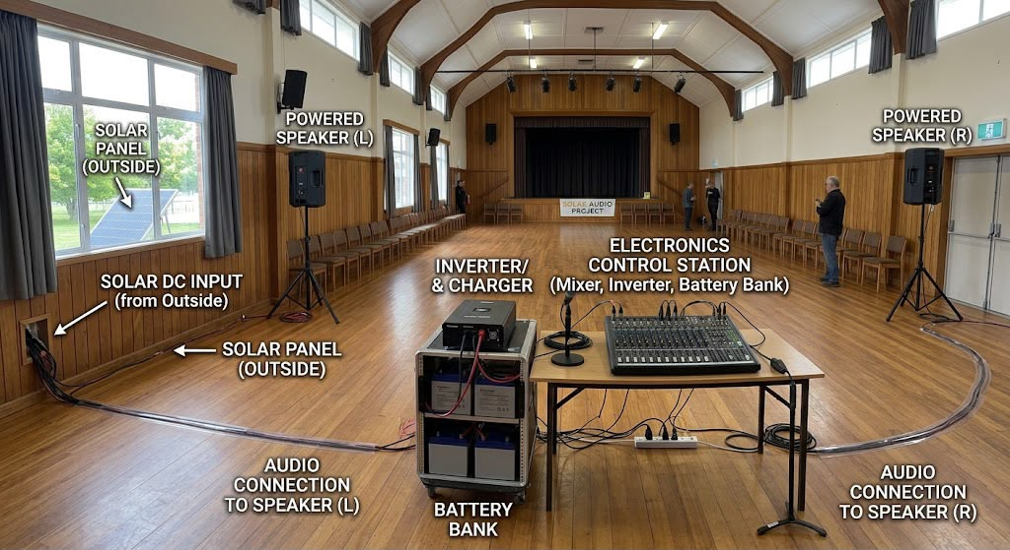
A Pictorial diagram of the connection of the Solar power PA system
Notes:
A Pictorial diagram of the connection of the Solar power PA system

Slide 6
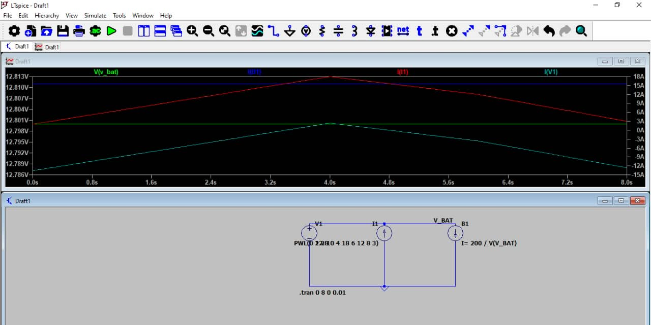
SIMULATION
System Validation (8:00 AM – 4:00 PM)• Continuous Load (🔵 dark Blue): Inverter draws a steady 15.6 Amps 200W) to power the audio mixer and wall-mounted speakers.• Solar Generation (🔴 Red): Follows the sun’s curve, peaking at 18.0 Amps at 12:00 PM noon to completely overtake the system load.• Net Battery Current (⛎ Light Blue): Drains in the morning (-13.6A), but switches to active charging (+2.4A) at noon with excess solar energy.• Battery Voltage (🟢 Green): Remains completely stable at 12.8 Volts, proving the system maintains equilibrium and will not crash.Conclusion: The 250W solar panel successfully powers the school PA system directly during peak hours while keeping the 100Ah LiFePO₄ battery safely charged.
Notes:
SIMULATION
System Validation (8:00 AM – 4:00 PM)
• Continuous Load (🔵 Light Blue): Inverter draws a steady 15.6 Amps (~200W) to power the audio mixer and wall-mounted speakers.
• Solar Generation (🔴 Red): Follows the sun’s curve, peaking at 18.0 Amps at 12:00 PM noon to completely overtake the system load.
• Net Battery Current (🌌 Dark Blue): Drains in the morning (-13.6A), but switches to active charging (+2.4A) at noon with excess solar energy.
• Battery Voltage (🟢 Green): Remains completely stable at 12.8 Volts, proving the system maintains equilibrium and will not crash.
Conclusion: The 250W solar panel successfully powers the school PA system directly during peak hours while keeping the 100Ah LiFePO₄ battery safely charged.

Slide 7
THANK YOU

